Slide 1
Intro to Neural Networks 1
Marlabs

Slide 2
Neural Networks
Neural networks are modeled after biological neural networks and attempt to allow computers to learn in a similar manner to humans.
Use cases:
Pattern Recognition
Times Series Prediction
Signal Processing
Anomaly Detection
Control

Slide 3
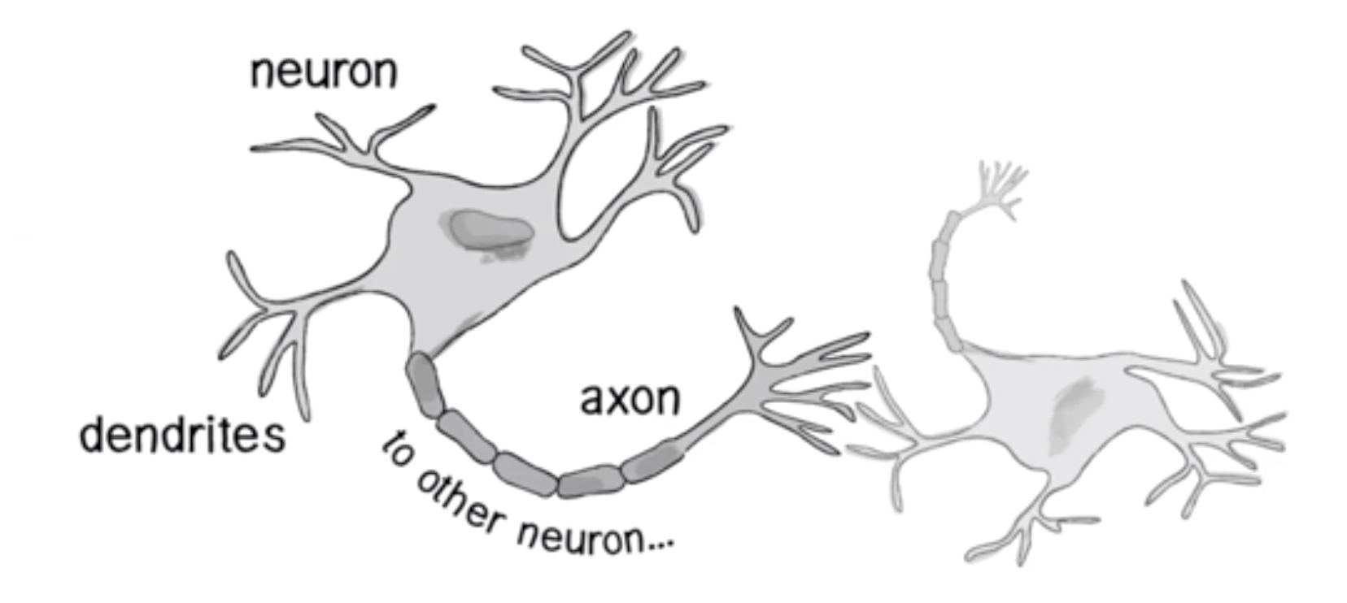
Neural Networks
The human brain has interconnected neurons with dendrites that receive inputs, and then based on those inputs, produce an electrical signal output through the axon.

Slide 4
Neural Networks
There are problems that are difficult for humans but easy for computers (e.g. calculating large arithmetic problems)
Then there are problems easy for humans, but difficult for computers (e.g. recognizing a picture of a person from the side)
Neural Networks attempt to solve problems that would normally be easy for humans but hard for computers.
The simplest Neural Network: the perceptron

Slide 5
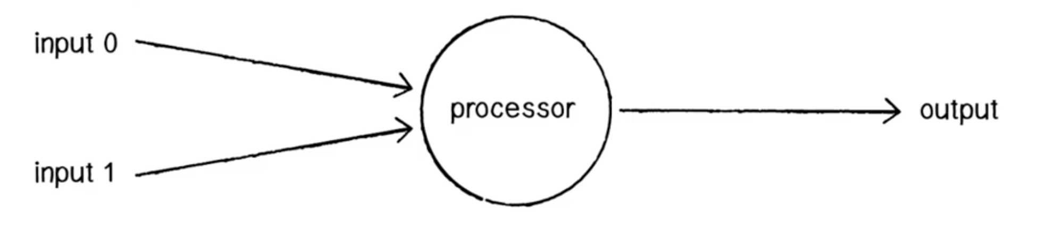
Perceptron
A perceptron consists of one or more inputs, a processor, and a single output.
A perceptron follows the “feed-forward” model, meaning inputs are sent into the neuron, are processed, and result in an output.

Slide 6
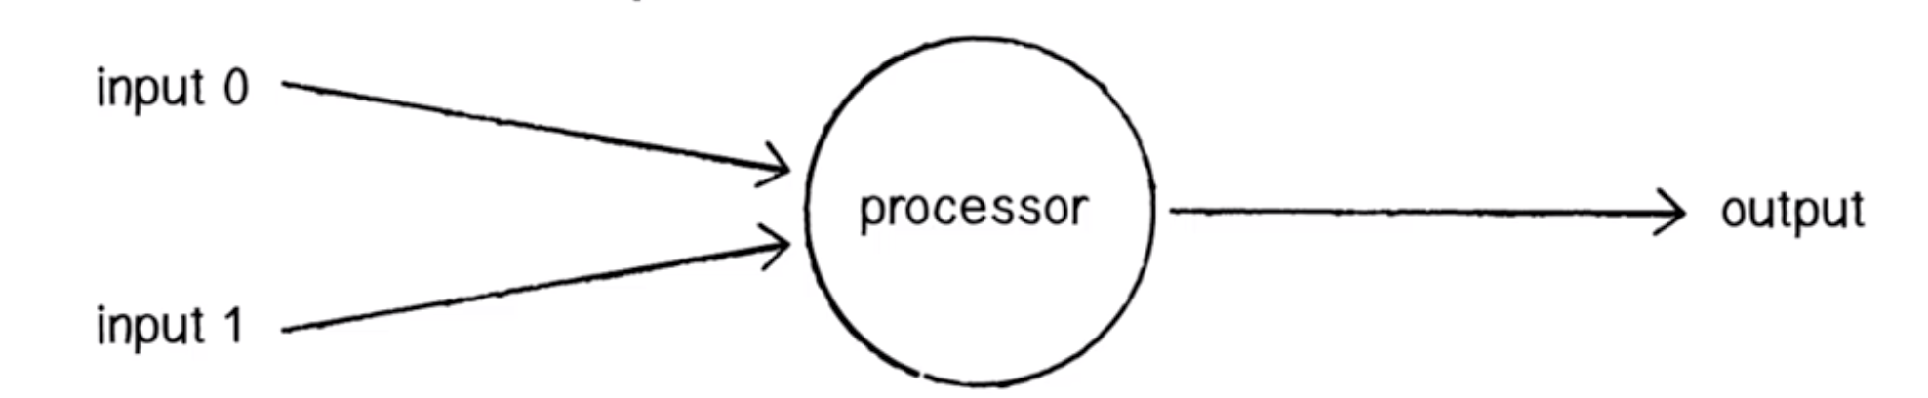
Perceptron Process Steps
A perceptron process follows 4 main steps:
Receive Inputs
Weight Inputs
Sum Inputs
Generate Output

Slide 7
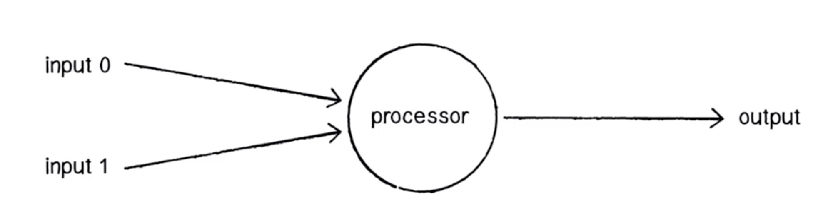
Perceptron
E.g. we have a perceptron with two inputs:
Input 0: 12
Input 1: 4

Slide 8
Perceptron
Each input that is sent into the neuron must first be weighted, i.e. multiplied by some value (often a number between -1 and 1).

Slide 9
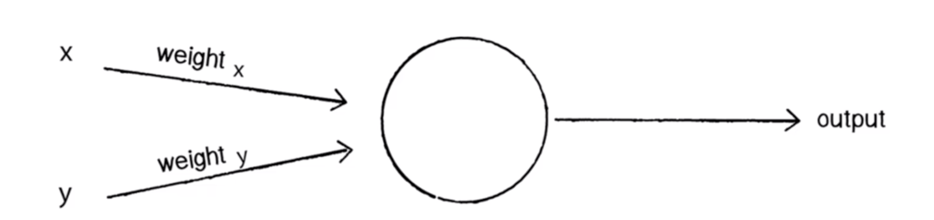
Perceptron
When creating a perceptron, we’ll typically begin by assigning random weights.
Weight 0: 0.5
Weight 1: -1

Slide 10
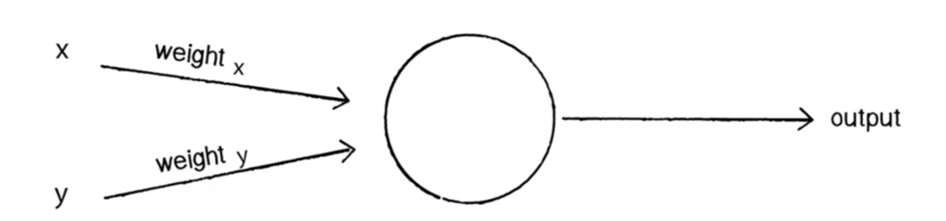
Perceptron
We take each input and multiply it by its weight.
Input 0 * Weight 0 = 12 * 0.5 = 6
Input 1 * Weight 1 = 4 * -1 = -4

Slide 11
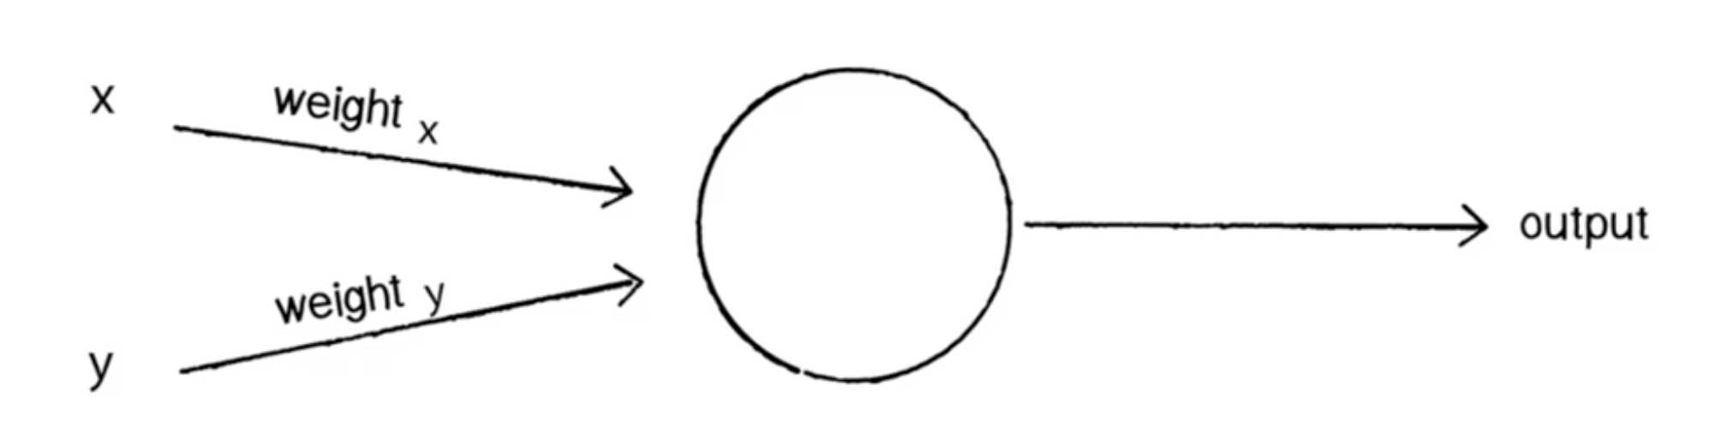
Perceptron
The output of a perceptron is generated by passing that sum through an activation function. In the case of a simple binary output, the activation function is what tells the perceptron whether to “fire” or not.

Slide 12
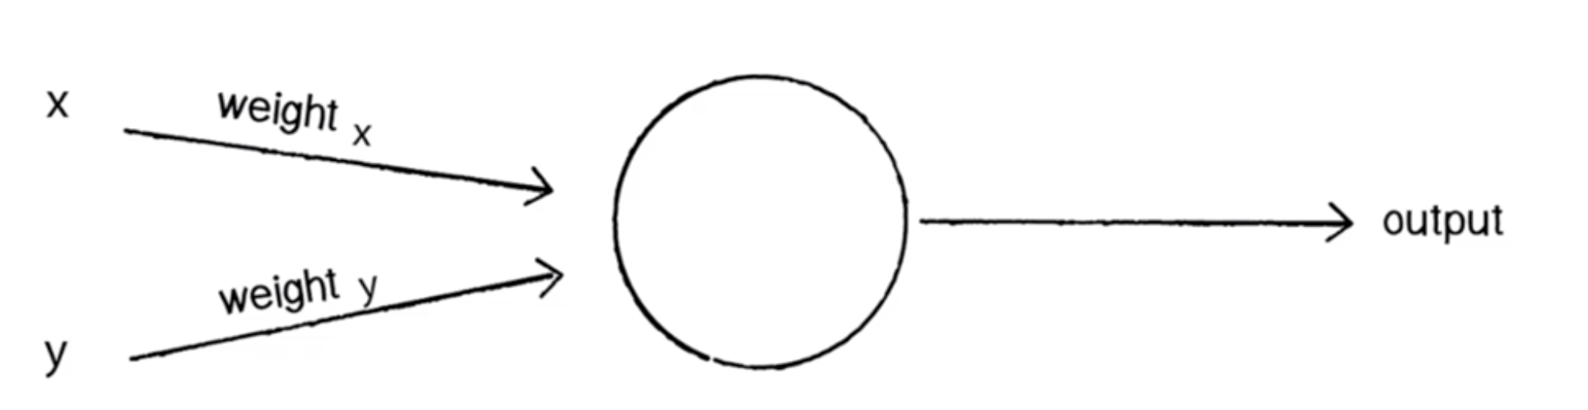
Perceptron
Many activation functions to choose from (Logistic, Trigonometric, Step, etc …). Let’s make the activation function the sign of the sum. In other words, if the sum is a positive number, the output is 1; if it is negative, the output is -1.

Slide 13
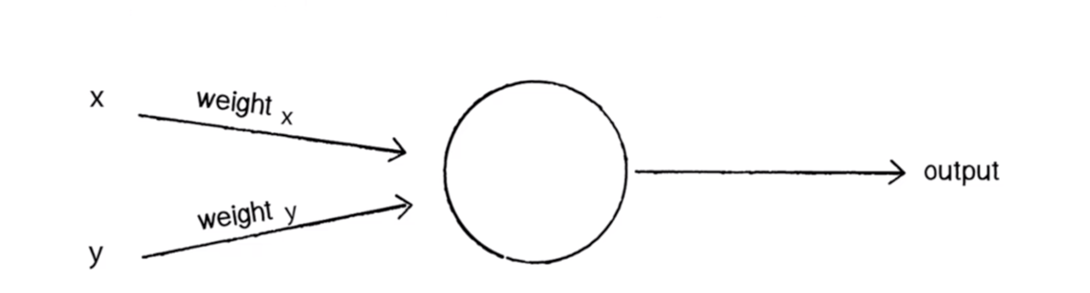
Perceptron
One more thing to consider is Bias. Imagine that both inputs were equal to zero, then any sum no matter what multiplicative weight would also be zero!

Slide 14
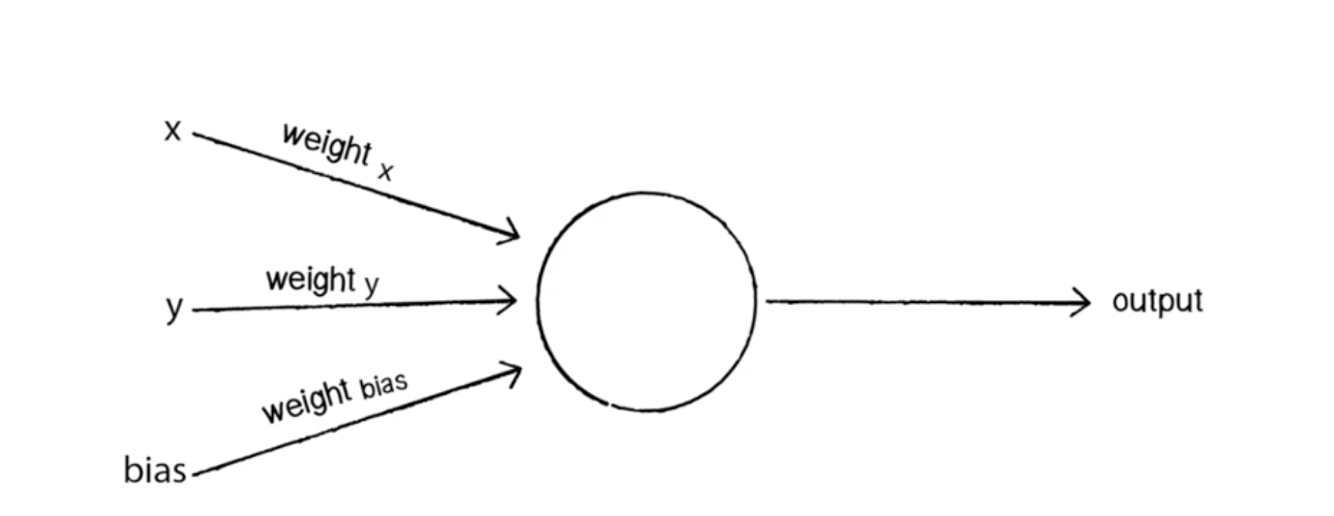
Perceptron
To avoid this problem, we add a third input known as a bias input with a value of 1. This avoids the zero issue!

Slide 15
Actually Train the Perceptron Steps
Provide the perceptron with inputs for which there is a known answer.
Ask the perceptron to guess an answer
Compute the error. (How far off from the correct answer?)
Adjust all the weights according to the error
Return to Step 1 and repeat.
We repeat this until we reach an error we are satisfied with.
This is how a single perceptron would work, now to create a neural network all you have to do is link many perceptron together in layers.

Slide 16
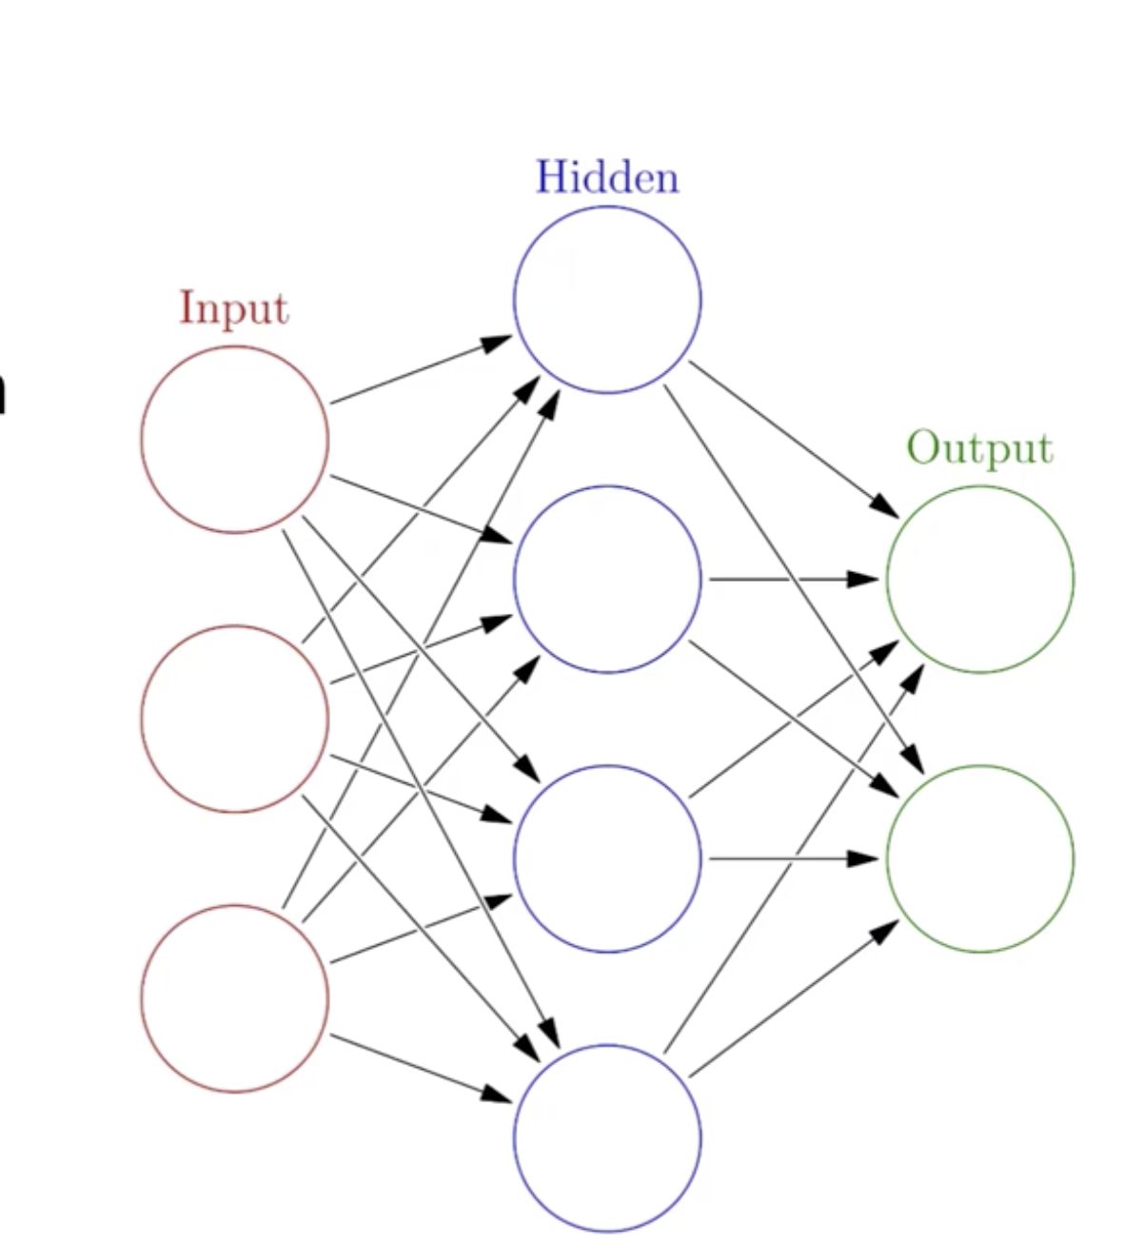
Neural Networks
You’ll have an input layer and an output layer.
Any layers in between are known as hidden layers, because you don’t directly “see” anything but the input or output.

Slide 17
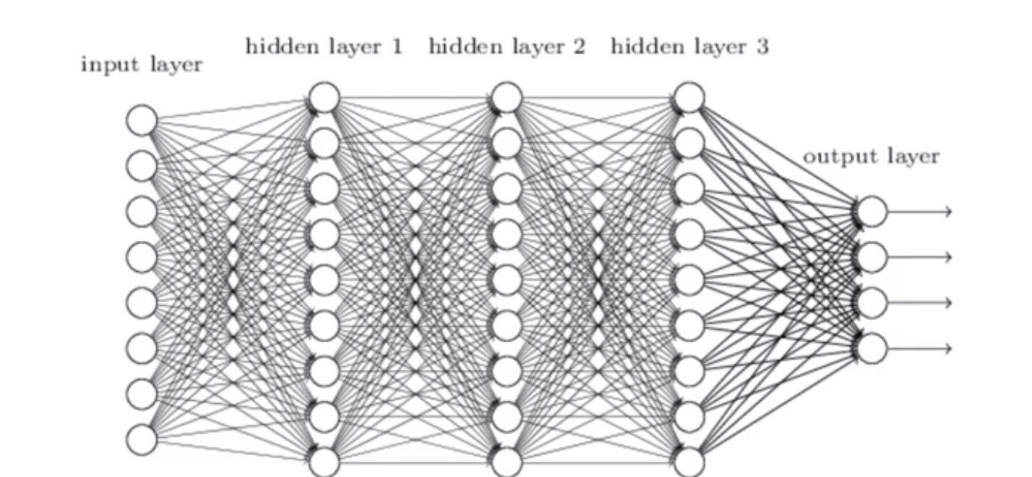
Neural Networks
Deep Learning
Deep learning is just a Neural Network with many hidden layers, causing it to be “deep”. E.g., Microsoft’s state of the art vision recognition uses 152 layers.

